Slide 1
Introduction to Programming (with Python)
Python Programming for Biologists Seminar Series
R. Burke Squires
NIAID BCBB

Slide 2
Outline
Why…
How…
…should you learn to program?
…do we have to program a computer?
…should someone learn python?
…can programming help you?
…does one program a computer?
…can you learn more?
Notes:
How Can Programming Help Us?
Why Do We Have To Program A Computer?
How Do You Program?
Which Language Do You Choose?
Where Do We Program / Ides
What Features Are A Help To Scientists
Development In The 21st Century
Devops
Becoming A Reproducible Scientist
On The Cutting Edge – Deep Learning

Slide 3
Learning Objectives
Enable you to…
compare and contrast computer hardware, software (program), and programming languages
communicate better with programmers, bioinformaticians
convert pseudocode to actual source code
make your research more reproducible
Enable you to “see” when a program would be useful
Enable you to think more clearly
Notes:
Update

Slide 4
Motivation

Slide 5
What Are Some Examples of How Programming Can Help?
Re-run an entire analysis on new data, (almost) instantly
“Glue” program output and input together into a single workflow
Test multiple parameters all at the same time
Download data from a known location and process it…automatically
Create, update, move, and/or rename files and folders easily
Create a web portal or graphical user interface for your software
…automate the boring stuff!

Slide 6
Why Should You Learn To Program?
Opportunities to make your research
FASTER - Repeat an entire analysis by just replacing the input
BETTER – Validate your analysis, use statistics
REPRODUCIBLE - Make your research (more) reproducible
MORE COMPETATIVE – many other researchers will be using these similar techniques

Slide 7
Challenges of Programming
Picking a programming language
Learning a programming language
Knowing which piece of the language to use
Debugging!!!
Remembering what the program does when you come back to it.
Keeping track of different programs
Programing requires: Practice, practice, practice!

Slide 8
You Have (Probably) Programmed Before… and You May Not Even Know It?
Written a formula in Excel
Recorded a macro in Excel

Slide 9
Why Do We Need To Program Computers?

Slide 10
Computers
http://www.apple.com
Compute Cluster /
High-performance computer (HPC) /
Supercomputer
https://computing.llnl.gov/tutorials/linux_clusters/

Slide 11
How Do Computer Communicate?
Binary digit– 1, 0
Electrical impulses
“Bit”
“Byte”
8 bits (0s, 1s)
“Word”
64 bit (32 bit) – 8 bytes at a time
Width of communication path in central processing unit (CPU)
I7, i5, Xeon, Athlon
http://engineering.integrisgp.com/wp-content/uploads/2015/10/computer-speak.jpg

Slide 12
What Does This Mean For Us?

Slide 13
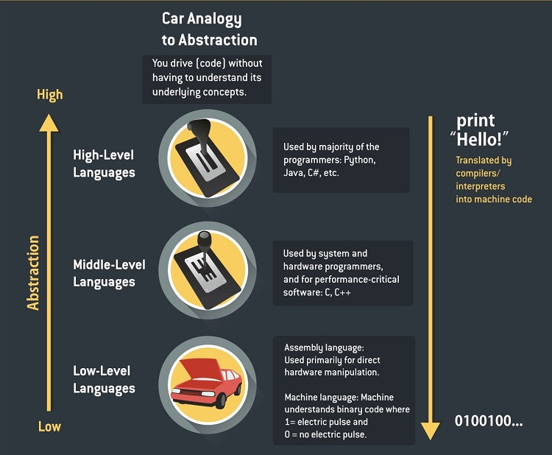
Programming Languages
Computers “speak” 1s, 0s
Human speak English, etc.
Programming Language Levels
Machine language (0, 1)
Interpreted directly in hardware
Assembly language
Wrappers over machine language
High-level languages (C, Java)
Machine-independent language
Scripting languages (Python, R, perl)
High-level and powerful
http://carlcheo.com/what-is-programming-what-do-programmers-do

Slide 14
Interpreters / Compilers
How do we go from high-level languages to assembly?
Interpreter (Python, R)
Compiler (C, C++, Java)
We write program “source code”
Usually saved as a file
We “run” or “execute” program
http://www.hackersclub.io/single-post/2016/04/06/Scripting-vs-Coding-vs-Programming

Slide 15
Printing “Hello World!”
C++
#include <iostream>
int main()
{
std::count << "Hello World” << std::endl;
return 0;
}
Python
print(“Hello World!”)
Java
public class HelloWorld {
public static void main (String[] args) {
System.out.println("Hello World!");
}
}
R
print("Hello World!", quote = FALSE)

Slide 16
Why Learn to Program in Python
A general purpose, high-level language
Cross-platform and open source
An interpreted language (no need to compile)
Easy to read language
Powerful
Fast (with package numpy, etc)
“Batteries included” standard library
Great Community
Many package available
Lots of help and tutorials
Easy installation (with anaconda distribution)
Popular for data science

Slide 17
Python Scientific Computing Packages
Numpy – fast matrix calculations
Pandas – scientific data analysis
Matplotlib – a MATLAB-like plotting library
SageMath – a large mathematical software application for linear algebra, combinatorics, numerical mathematics, calculus, and more
SciPy – a large library of scientific tools
Scikit-learn – Machine learning
Stats-model – Statistical analysis
Jupyter – Analysis notebook / collaboration
Conda / bioconda - installers

Slide 18
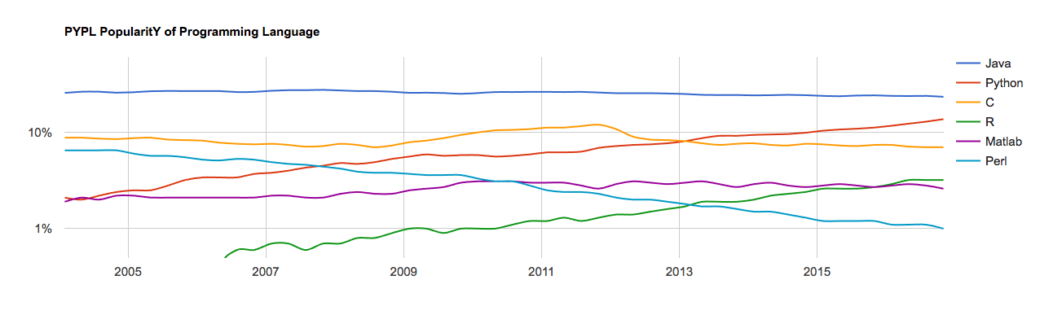
Language Popularity

Slide 19
How To Write A Program?

Slide 20
How Do We Program?
Think About Your Workflow (Algorithm)
Write Pseudocode
Break down our task into smaller tasks
Describe the major components of our program
Does this sound difficult?
Let’s look at an example that I suspect most of us are familiar with…
Convert pseudo code into a program or “source code”
Write in a text file

Slide 21

An Example Workflow: Coffee
Who drinks coffee?
Who makes coffee?
Who buys coffee?
What does it take to make a pot or cup of coffee?
(I’m a French Press type of coffee drinker)

Slide 22
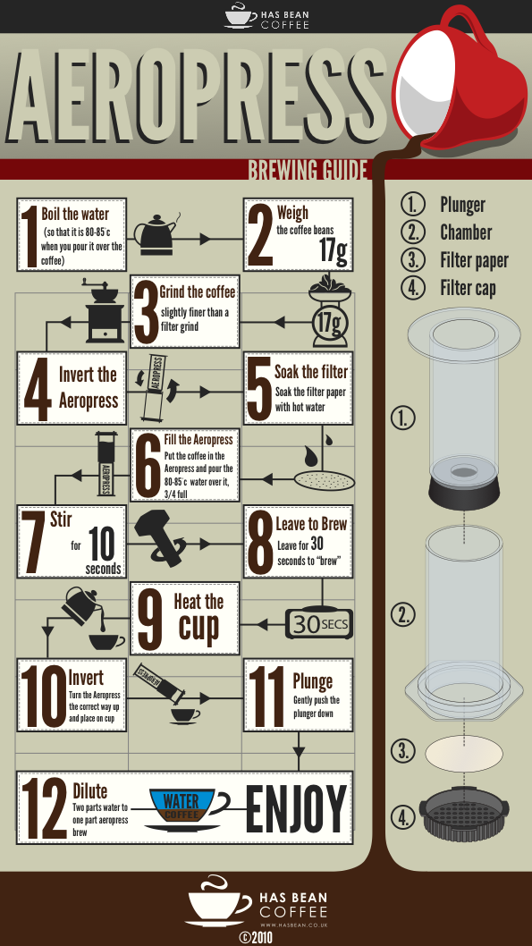
AeroPress…
Workflow…or…
Steps or
Recipe or
Protocol or
Flowchart…
Ultimately this is an algorithm

Slide 23
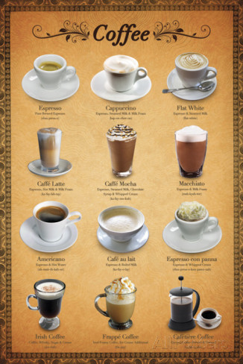
Coffee
What if I want to make different type of coffee drinks?
What is different about my recipe?
What is the same about my recipe?
Is reproducibility important?
What happens if you gave those exact instructions to a three year old?

Slide 24
Algorithm
?
Input =>
=> Output

Slide 25
A New Way Of Seeing The World
What we are really teaching is a new way of looking at a problem
See repetition in your work; have fun with it
Where have you all seen repetition in your work?
Find repetition even when it does not look like it; where is repetition hiding?
Reproducibility / reuse of code

Slide 26
What Are The Parts Of A Programming Language?

Slide 27
Writing Our Program
All programming languages share many of the same concepts
Data types
Data structures
Conditionals
Loops
Functions
Files input/output

Slide 28
Data Types
Integer
0, 1, 2, 999
Floating-point number, “Float”
3.14
Boolean
True, False
Character
“a”, “b”, “c”, “A”, “B”, “C”
String (of characters)
“ATCG”

Slide 29
Data Structures
Sequence Data Types
Array (List)
Ordered; duplicates allowed; can change
In python - [1, 2, 3], [ “A”, “B”, “C”]
Tuple
Ordered; duplicates allowed; cannot change
In python – tuple: (“a”, “t”, “g”, “c”);
Sets Data Types
Sets
Unordered; no duplicate elements
In python - Set(['John', 'Jane', 'Jack', 'Janice'])
Mapping Data Types
Hash (Dictionary)
Key / value pair
Unordered; no duplicate keys, can change
In python – { “BRCA1”: “cancer gene” }

Slide 30
Variables make use of data types and structures
Variables
Keywords / Reserved Words (python)
A specific string that stores a value during the runtime of a program
Refer to a place in memory where the value is held
Example
conc = 10
and
exec
not
assert
finally
or
break
for
pass
class
from
print
continue
global
raise
def
if
return
del
import
try
elif
in
while
else
is
with
except
lambda
yield

Slide 31
Operators
Definition
Order of Operators
An object that is capable of manipulating a value or operator
For example, in "1 + 2", the "1" and "2" are the operands and the plus symbol is the operator
Order | Operator | Name | Example
1 | = | Equals | a = b
2 | == | Equals | a == b
3 | != | Not equal | a != b
4 | + | Plus | a + b
5 | - | Minus | a - b
6 | / | Divide | a / b
7 | * | Times | a * b

Slide 32
Conditional Statements
Definition
Example(s)
A statement that is true only for certain values (conditions) of the variables or symbols
If conc == 10:
print(“Concentrations is 10 mm”)
else:
print(“Concentration is not 10 mm”)

Slide 33
Loops
For loop…
Execute a known number of times
While loop
Execute while some condition is met
# Measure some strings: ...
words = ['cat', 'window', 'defenestrate']
for w in words:
print(w, len(w))
def fib(n):
# write Fibonacci series up to n ""Print a Fibonacci series up to n."""
a, b = 0, 1
while a < n:
print(a, end=' ')
a, b = b, a+b
print()

Slide 34
Functions
Definition
Example
A basic task of a computer, especially one that corresponds to a single instruction from the user.
When an task needs to be performed more then once, it is a good opportunity to convert that code into a function
def multiply(num1, num2):
answer = num1 * num2
return answer

Slide 35
Input / Output
File I/O
Network (Socket) IO
Read a file
Text files
Binary files
Write a file
Text file
Binary file
Read from a socket / network connection
Write to a socket / network connection

Slide 36
How To Write a Program

Slide 37
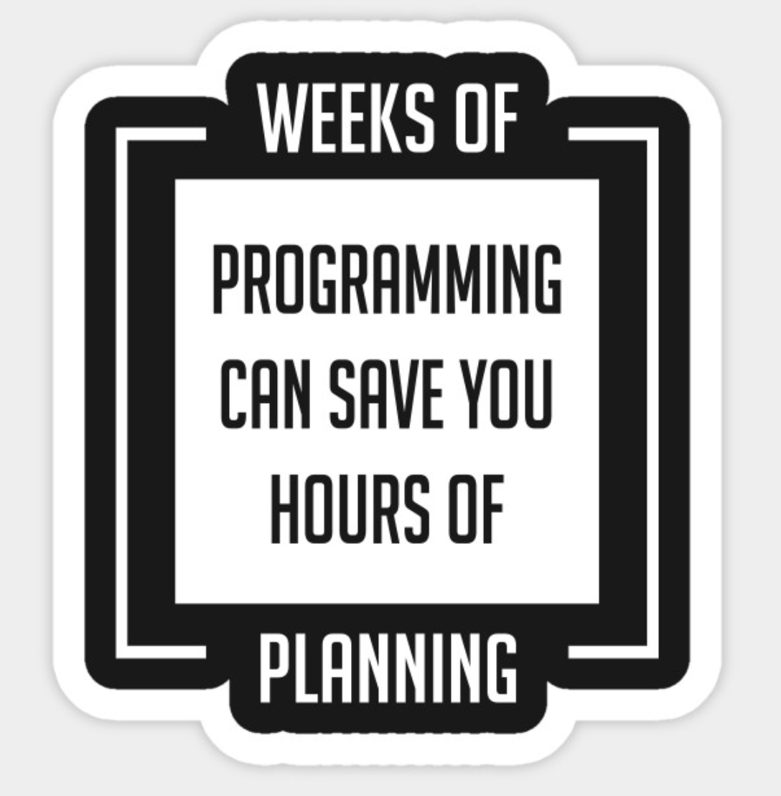
How To Write A Program
Think about the problem you want to solve
Outline the steps necessary to solve the problem
This is pseudocode
This is also your algorithm
Convert your pseudocode to real code
We will be writing our code in the python programming language
Run your code
Test your program

Slide 38
Think About The Problem You Want To Solve
What are the data types you will need to use / manage?
How will you store your data (i.e. what data strucures will you need to use?)
Are there any loops?
Are there any conditions?
Do you need to write any functions?

Slide 39
Debugging
Syntax – wrong grammar, i.e., breaking the rules of how to write the language
Forgetting punctuation, misspelling keyword
The program will not run at all with syntax errors
Logic - the program runs, but does not produce the expected results.
Using an incorrect formula, incorrect sequence of statements, etc.

Slide 40
How Do We Get Started?
Create a workflow of what you want your program to do
Usually call this “pseudocode”
Pseudocode consists of
Clear natural human readable language
Three rules
sequence
choice (if)
repeat (while)
Later we will create pseudocode then convert it to actual code

Slide 41
How Do We Convert Pseudocode to an Actual Program?
Write your own code, all from scratch
Write your own code but use packages
Modify existing code
Search for, adapt code written by some one else

Slide 42
Writing Our Program
Source code
Written in plain text
Write in
Text editor
Integrated development environment (IDE)
Jupyter Notebook
#!/usr/bin/python
# “This programs sums numbers given to it”
value = 1
sum = 0
print('Enter Numbers to add to the sum.')
print('Enter 0 to quit.')
while value != 0:
print('Current Sum:', sum)
a = float(input('Number? '))
sum = sum + value
print('Total Sum =', sum)

Slide 43
Code Is Read More Often Then It Is Written!

Slide 44
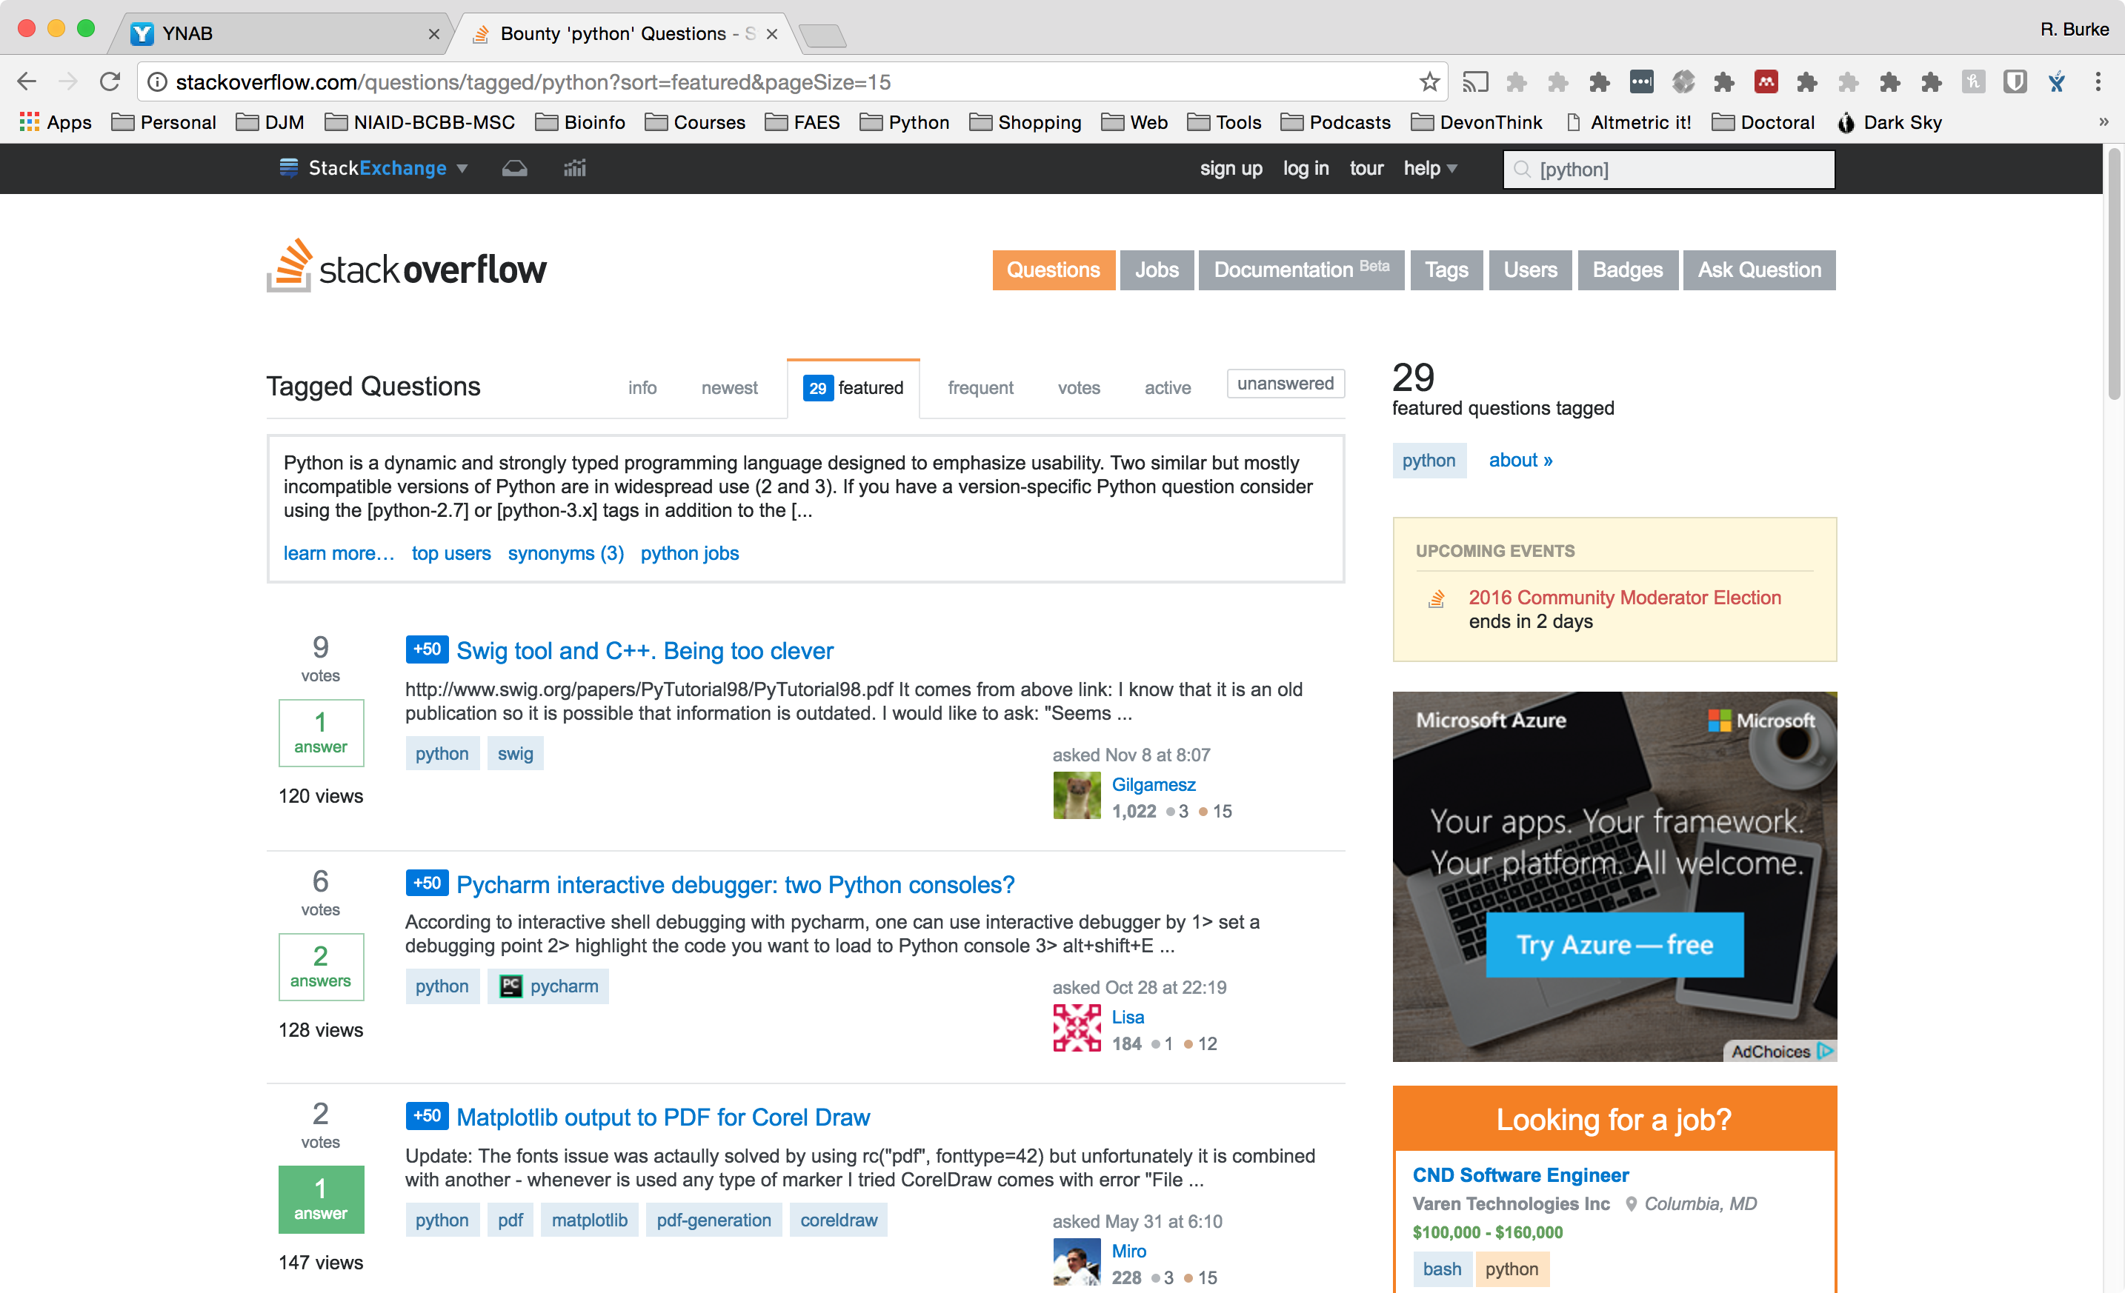
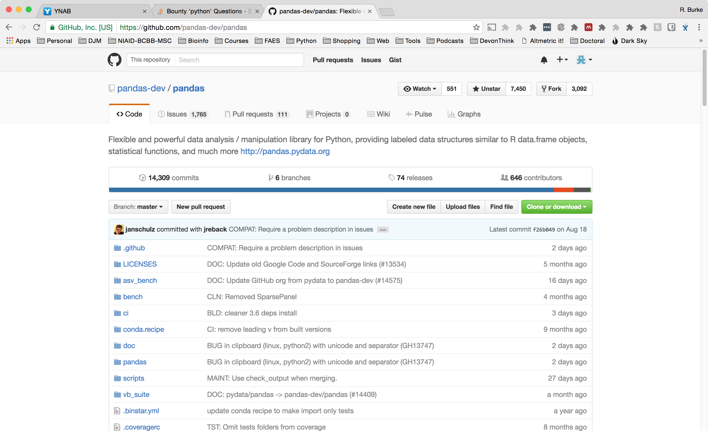
Where To Find Package or Code?
Your Previous Code
Other lab members code
Google Search
StackOverflow
GitHub (Open source, source code repository)
Programing language repository (python – pip, conda; R – cran)

Slide 45
How To Write Your Own Code?

Slide 46
How To Write Your Own Code?
Picking a Programming language
Usually the programming language most comfortable with
If you are new to programming, pick one of the languages that we see today
Pick the language that best fits the situation
Process
Start with pseudo code
Transform pseudo code into real code, one line at a time

Slide 47
Pseudocode Experiment
Long Term Evolution in E. coli Experiment
Analyze evolution in E. coli over 50,000+ generations
Hypothesis
All 12 strains will evolve at the same rate
To test our hypothesis we have sequences many generations and we now need a program to compare the sequences against each

Slide 48
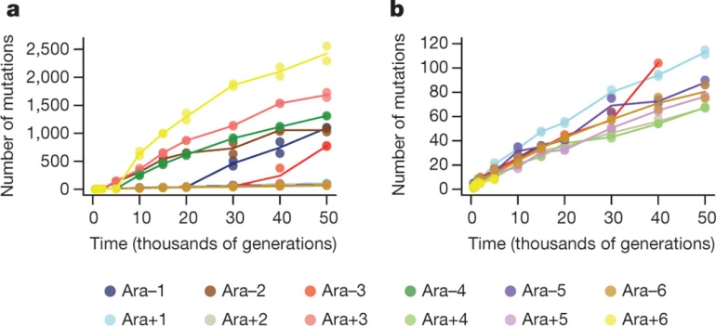
Total number of mutations over time in the 12 LTEE populations
O Tenaillon et al. Nature 1–6 (2016) doi:10.1038/nature18959

Slide 49
Pseudocode What do we want our program to do?
Assumptions
We have a reference sequence (in fasta)
We have three sequences for each strain / year (in fasta)
Organize by strain name, year
Ara-1, 2, 3, 4, 5, 6
Ara+1, 2, 3, 4, 5, 6
Hints
The EMBOSS suite has program to compute the differences between two sequences

Slide 50
Pseudocode What do we want our program to do?
Get reference sequence
Loop
Read data file(s)
Calculate mutations
Average among replicates
Save data
Plot data

Slide 51
Pseudocode What do we want our program to do?
Define input files and output files
Use the reference genome to get gene positions and genome sequence
Use the simplified gene file to compute for each position in the genome a coding status
First read of data to identify all mutations with a unique tag per population
Attribute to each mutation a coding status and filter
Count mutations per categories at any given sampling time
Print an array for R to build a phylogeny

Slide 52
Excersize

Slide 54
Advanced Concepts

Slide 55
Advanced Concepts
Data Structures
Algorithms
Big O Notation
P vs NP Problem
Dynamic Programming
Greedy Programing
Development Methodologies
Waterfall
Agile Development
Parallel Computing
Embarrassingly Parallel
Graphical Processing Unit (GPU) Computing
Machine Learning
Deep Learning
DevOps
Version Control
Continuous Integration
Containers (Docker)
Cloud Computing
Other
Application program interface (API)?
Common Workflow Language (?)

Slide 56
Data Structures
Array (or list)
Hash Table (dictionary)
Heap
Graph
Linked List
List
Queue
Stack
Tree
Binary search tree
Table comparing data structures
Mutable, immutable
Ordered, unordered
What they are called in different programming languages
For animations of data structures, please see here:
https://www.cs.usfca.edu/~galles/visualization/Algorithms.html

Slide 57
Data Structures
Array
Hash Table
[x, y, z]
An ordered set of data
A set of variables that each store an item
After deleting an element:
[x, , z]
Data Structure Visualizations: https://www.cs.usfca.edu/~galles/visualization/Algorithms.html

Slide 58
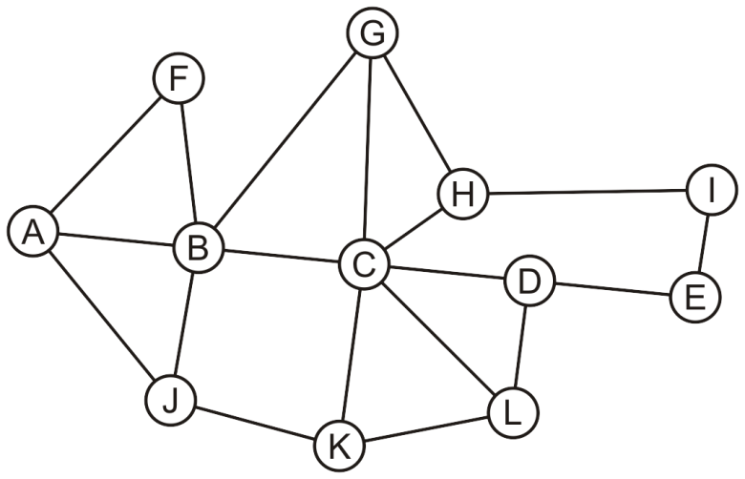
Data Structures
Graph
List
[1, 2, 3, 4, 5, 6]
An ordered set of data
A set of items
After deleting an element:
[1, 2, 4, 5, 6]
undirected graph

Slide 59
Data Structures
Linked List
Queue
First in, First Out Queue
Source: https://en.wikipedia.org/wiki/Linked_list
https://en.wikipedia.org/wiki/Queue

Slide 60
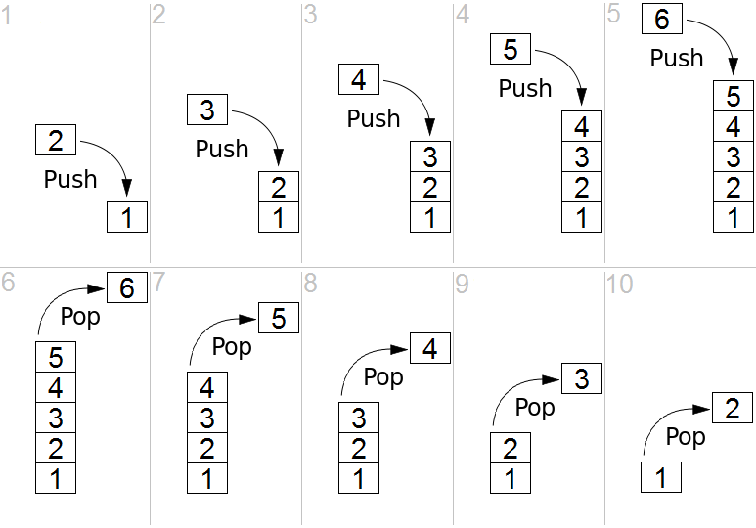
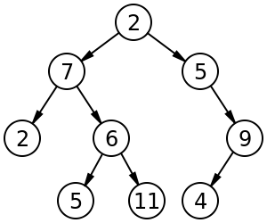
Data Structures
Stack
Tree
Last in, First Out

Slide 61
Algorithms

Slide 62
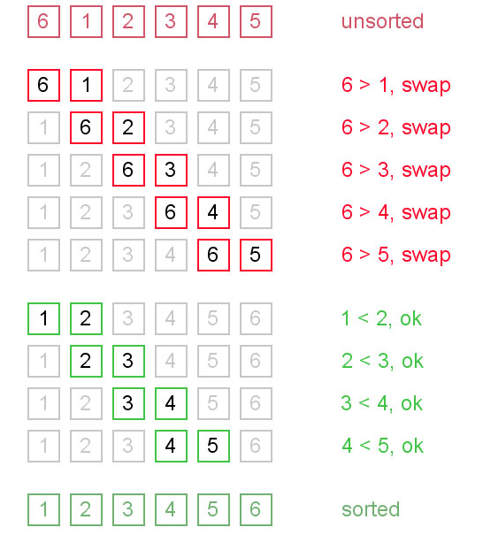
What Is An Algorithm
Definition
Noun
A step-by-step procedure for solving a problem or accomplishing some end especially by a computer <a search algorithm> (Merriam-Webster)
In other words…a “recipe” or “protocol” for the computer
Bubble sort algorithm
Compare two numbers, if number on left is bigger, swap
Repeat

Slide 63
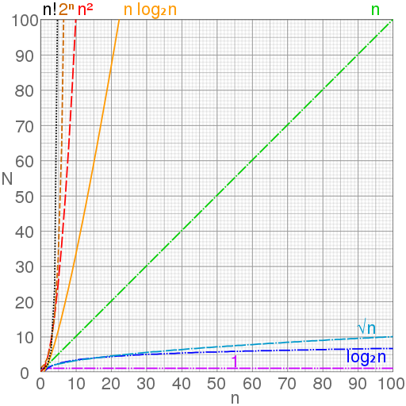
Big O Notation
Pick a number between 1 and 10
I will tell you if the number if too high or two low
How many guesses do you need to get the number? Usually 3 – 4 or nearly log(10)
Now how many guesses do you think it would take if the options were to a million?
Big O Notation
Approximately how long an algorithm will take to run

Slide 64
Big O Notation
Growth Rate | Name | Code Example | Description
1 | Constant | a= b + 1; | statement (one line of code)
log(n) | Logarithmic | while(n>1){ n=n/2; } | Divide in half (binary search)
n | Linear | for(c=0; c<n; c++) { a+=1; } | Loop
n*log(n) | Linearithmic | Mergesort, Quicksort, … | Effective sorting algorithms
n^2 | Quadratic | for(c=0; c<n; c++) { for(i=0; i<n; i++) { a+=1; } } | Double loop
n^3 | Cubic | for(c=0; c<n; c++){ for(i=0; i<n; i++){ for(x=0; x<n; x++){ a+=1; } } } | Triple loop
2^n | Exponential | Trying to break a password generating all possible combinations | Exhaustive search
http://adrianmejia.com/blog/2014/02/13/algorithms-for-dummies-part-1-sorting/

Slide 65
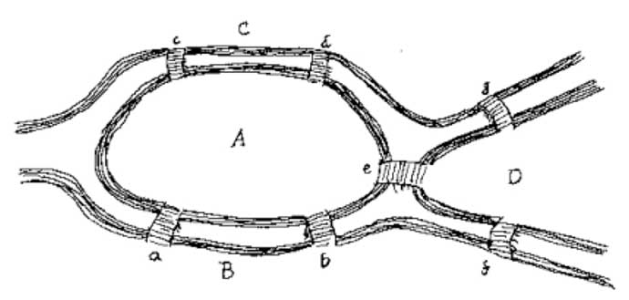
Algorithms P vs NP Problem
Polynomial versus nondeterministic polynomial time
How long it takes to solve a problem versus how long it takes to verify there is a solution
NP-complete problems
Harder to compute than verify
Example
7 Bridges
Euler wondered if a person could walk across each of the seven bridges once and only once to touch every part of the town.
Notes:
Euler…Starting and ending at the same spot was not a requirement

Slide 66
Dynamic Programming
Method for solving a complex problem by breaking it down into a collection of simpler sub-problems
Solving each of those sub-problems just once, and storing their solutions
The next time the same sub-wwwwwwwwwwwwwwwproblem occurs, instead of recomputing its solution, one simply looks up the previously computed solution
Notes:
Figure 1 - The filled dynamic programming matrix for two DNA sequences, x = TTCATA and y = TGCTCGTA, for a scoring system of +5 for a match, -2 for a mismatch and -6 for each insertion or deletion.
From the following article
What is dynamic programming?
Sean R Eddy
Nature Biotechnology 22, 909 - 910 (2004)
doi:10.1038/nbt0704-909

Slide 67
Greedy Programing
Problem solving heuristic of making the locally optimal choice at each stage with the hope of finding a global optimum

Slide 68
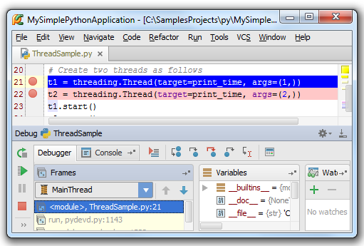
Debugging
Majority of programming time
75 – 80% of programming
How
Can use print statements or
Integrated development environment (IDE) software
Software to write software
Set break-points
See what is happening in program during execution

Slide 69
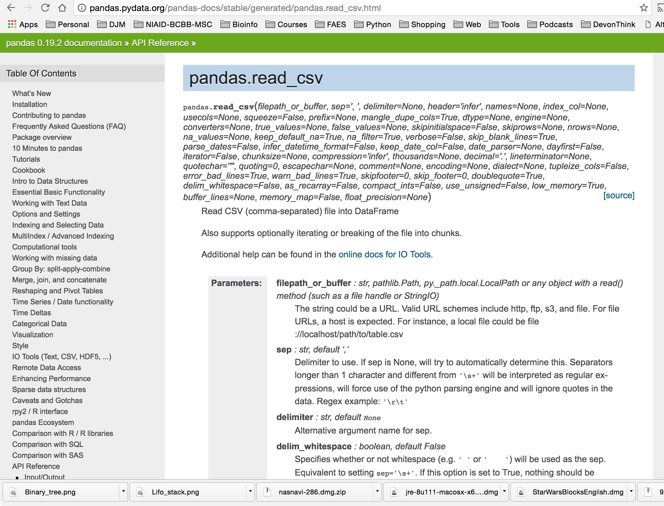
Application Program Interface (API)

Slide 70
Test-driven Development
Testing your software
How
Unit test
Assert
TDD Procedure
Write test before writing code
Only write enough cost to pass test
Write another test
Repeat
# content of test_sample.py
def func(x):
return x + 1
def test_answer():
assert func(3) == 5

Slide 71
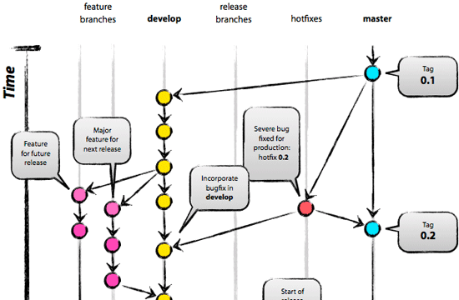
Version Control
Keep track of changes (versions)
Always have a working copy
Create branches to add or test features
Merge branches
Enables multiple programmers to work at the same time

Slide 72
Development Methodologies
Waterfall
Agile Development
Do all planning
Write all code
Perform all tests
Release product
Concern
Very difficult to do all planning in beginning and anticipate all problems
Iterate
Plan one part
Write code to part
Test one part
Release one part
Repeat

Slide 73
Parallel Computing
Breaking a problem into smaller subparts
Running each smaller part on separate core or computer
Single data stream
SISD, MISD
Multiple data streams
SIMD, MIMD, SPMD, MPMD
Also
Embarrassingly Parallel

Slide 74

Graphical Processing Unit (GPU)
Central Processing Unit
Graphical Processing Unit
Intel Processor – Pentium, i7, Xeon
“Brain” of laptop and servers
2, 4, or more “cores” / little brains
Graphics cards / Video cards
Up to 3584 NVIDIA CUDA® Cores
Up to 12 GB RAM
Must write specific code to take advantage of

Slide 75
Machine Learning
Machine Learning
Deep Learning
“Learning”
Supervised learning
Support vector machines
Artificial Neural network
Bayesian methods
Random Forests
Unsupervised learning
Clustering
Dimensionality reduction
Structure prediction
Uses artificial neural network
Multiple hidden layers in network
Tries to model the way the human brain processes light and sound into vision and hearing
Needs training
Has been shown to out perform experts with minimal training

Slide 76
Development - Operations (DevOps)
Combination of programming (development) and operations
Operations
Hardware, software that are used to run websites, software
Utilizes
Version Control
Continuous Integration
When new update to software is detected (using version control), automatically runs test, compiles and puts into production
Containers (Docker)
An abstraction of hardware (software pretending to be hardware)
Allows one to download a single “file” with everything needed to run some doftware

Slide 77
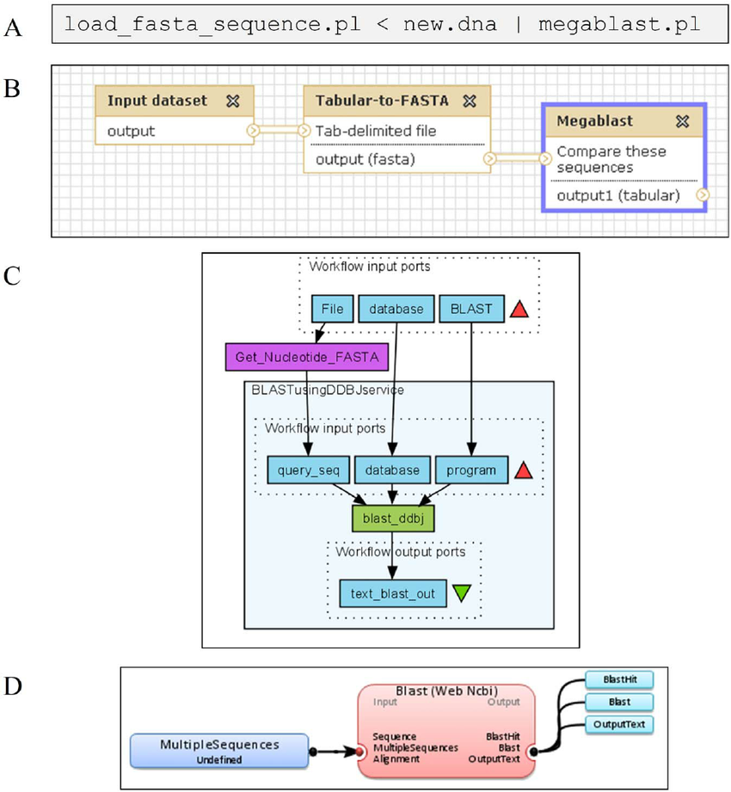
Workflow / Pipeline
The combining of multiple programs to steps into a single process
Enable
Automation
Scaling
Reusable
Reporting
Common Workflow Language
New standard for writing workflow instructions
Armadillo 1.1: An Original Workflow Platform for Designing and Conducting Phylogenetic Analysis and SimulationsArticle in PLoS ONE 7(1):e29903 2012
Notes:
Figure 1. Comparison of four different bioinformatics platforms for sequence search (i.e., the BLAST algorithm is used in all of them). Panel (A) presents a standard pipeline using Perl scripting; Panels (B, C, D) show different workflow designs for the sequence search operation provided by Galaxy (B) [10], Taverna (C) [27] and the introduced Armadillo workflow platform (D). doi:10.1371/journal.pone.0029903.g001

Slide 78
Getting Started

Slide 79
Learning Objectives
To familiarize you with computer programming, programming languages, scientific packages
Enable you to communicate better with programmers, bioinformaticians
Critique existing source code for your use
Assess which language that bests fits your needs
Facilitate you becoming a reproducible scientist
Notes:
Update

Slide 80
Resources
Algorithms
https://www.manning.com/books/grokking-algorithms
https://www.toptal.com/developers/sorting-algorithms
General python
https://docs.python.org/3/tutorial/index.html

